Slide 1
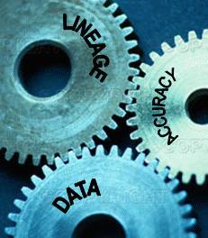
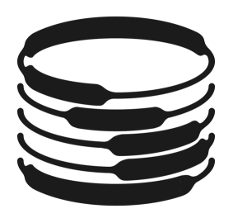
Trio
A System for Integrated Management of Data, Accuracy, and Lineage
Jennifer Widom
Stanford University

Slide 2
Basic Premise
Traditional Database Management Systems (DBMS’s) are too rigid for some applications
  Every data item is either in the database or it isn’t
  Its value is absolute
  Its derivation history is irrelevant
Trio relaxes these constraints by making:
    Data
    Accuracy
    Lineage
all first-class interrelated concepts

Slide 3
Formula for a Database Research Project
Consider traditional DBMS’s – highly sensitive to their basic assumptions
Add a twist or two
Forced to reconsider many aspects of data management and query processing
  Data model and algebra, query language, query optimization and execution, index structures, storage structures, application and user interfaces, …
  Many Ph.D. theses
  Significant prototype effort

Slide 4
Next in the Talk
Trio features – overview of the twists Trio introduces to a conventional DBMS
Specific project goals and non-goals
A quiz, to wake you up
Several motivating applications

Slide 5
Trio Features: Accuracy
Data values may be inexact
  Ex: A numeric value lying somewhere in the range [ 3.2 , 4.4 ]
  Ex: A record belonging in the database with probability 97%
  Ex: A relation missing about 15% of its records

Slide 6
Trio Features: Accuracy
Queries over inexact data return inexact answers
  Ex: This result value lies somewhere in the range [1,6]
  Ex: This record belongs in the result with probability 85%
  Ex: This answer is missing about 25% of its records

Slide 7
Trio Features: Lineage
Lineage is an integral part of the data model
  Suppose record r was derived by query Q over data D at time T. Trio keeps track.
  Lineage captures:
    Query-based derivations
    Program-based derivations
    Update-based derivations
    Bulk data loads
    Data import from outside sources

Slide 8
Trio Features: Querying Accuracy
Accuracy may be queried
  Ex: Find all numeric values whose approximation is within 1%
  Ex: Consider only records with ≥ 98% chance of belonging in the database

Slide 9
Trio Features: Querying Lineage
Lineage may be queried
  Ex: Find all records whose derivation includes data from relation R
  Ex: Determine whether record r was derived from data imported on 4/1/04

Slide 10
Trio Features: Combining Lineage, Accuracy
Lineage and accuracy may be combined in queries
  Ex: Find all records derived solely from high-confidence data

Slide 11
Trio Features: Enhancing Updates
Lineage can be used to enhance updates
Data updates
  Propagate updates from base to derived data (or vice-versa), similar to materialized views
Accuracy updates
  When data becomes more (or less) exact, compute and propagate effect on accuracy of derived data

Slide 12
Trio is Not…
A comprehensive temporal DBMS
A DBMS for semistructured data
The last word in approximate or uncertain data, or in data lineage
A federated or distributed system

Slide 13
Main Contributions – Trio Goals
Simple and usable model incorporating both accuracy and lineage
Query language that extends SQL to handle data, accuracy, and lineage together
Working system that is straightforward and efficient enough to actually get used

Slide 14
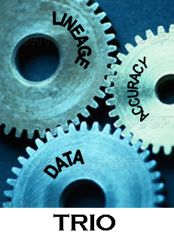
--- Quiz Time ---
What’s wrong with this logo?

Slide 15
Motivating Applications
No lack of them
  How similar are they really?
  Can we accommodate all of them?
  Which 2-3 “killer apps” should we focus on?

Slide 16
Scientific Data Management
Scientific experiments produce vast amounts of data
  Often structured but inexact
Additional data imported from outside sources
  Sources vary in quality and reliability
Many levels of derivation and aggregation
Data and accuracy evolve over time
A perfect fit for Trio

Slide 17
Sensor Data Management
Some sensor environments permit centralized collection
  With sufficient bandwidth and battery power
Readings may still be unreliable
  Missing values, incorrect values
Many levels of derivation and aggregation
  May want to trace to original sensor readings
Another perfect fit

Slide 18
Data Cleaning
Deduplication: Find and merge items likely to represent the same real-world entity
  Uncertainty in data, in match, and in merge
“Merge history” (lineage) important for:
  Computing and propagating uncertainty
  Unmerging
Yet another perfect fit!
Related application: “Profile Assembly”

Slide 19
More Applications
Storing/querying approximate values
Hypothetical reasoning
Online query processing
Privacy preservation
And others…

Slide 20
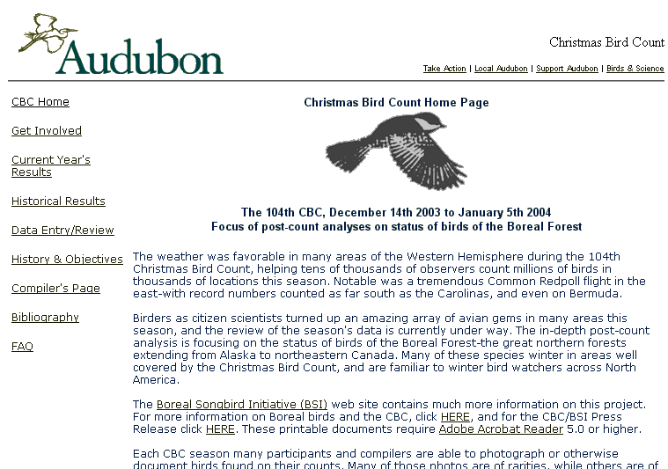
Running Ex: Christmas Bird Count

Slide 21
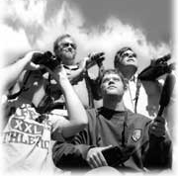
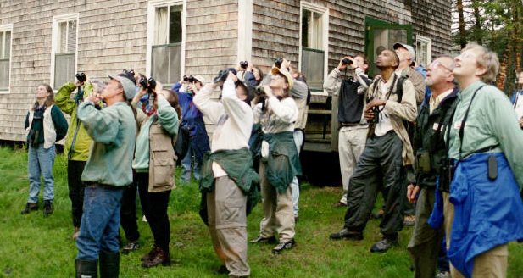
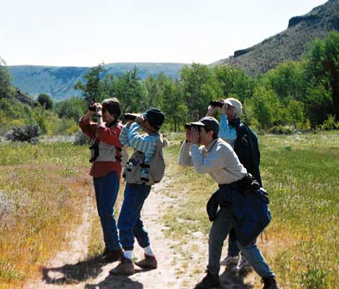
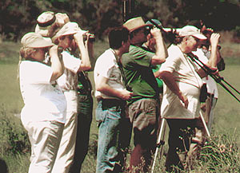

Bird Counters

Slide 22
Remainder of the Talk
The Trio Data Model – TDM
  A solid proposal
The Trio Query Language – TriQL
  Basic features
  Underlying algebra
The Trio System – Trio
  Very basic architectural choices

Slide 23
The Trio Data Model (TDM)
WARNING: This model is preliminary and subject to change
Data: relational (+ user-defined types)
Accuracy: approximation, confidence, and coverage
Lineage

Slide 24
TDM: Accuracy
Attribute-level approximation
Tuple-level (or relation-level) confidence
Relation-level coverage

Slide 25
TDM: Approximation
Broadly, an approximate value is a set of possible values along with a probability distribution over them

Slide 26
TDM: Approximation
Specifically, each Trio attribute value is either:
    Exact value (default)
    Set of values, each with prob ∈ [0,1] (∑=1)
    Min + Max for a range (uniform distribution)
    Mean + Deviation for Gaussian distribution
Type 2 sets may include “unknown” (┴)
Independence of approximate values within a tuple

Slide 27
TDM: Confidence
Each tuple t has confidence ∈ [0,1]
  Informally: chance of t correctly belonging in relation
  Default: confidence=1
  Can also define at relation level

Slide 28
TDM: Coverage
Each relation R has coverage ∈ [0,1]
  Informally: percentage of correct R that is present
  Default: coverage=1

Slide 29
True Meaning of Accuracy
Question: What does inaccurate data really mean?
Answer: Nothing in particular
  We provide the mechanisms
  Application determines interpretation
Sort of

Slide 30
Accuracy in CBC
Each participant P: P-sightings (time, latitude, longitude, species)
Approximation
  time, latitude, longitude: range or Gaussian
  species: set of values with probabilities; may include ┴
Confidence: based on P’s capabilities or experience; tuple- or relation-level
Coverage: fraction of activity captured by P

Slide 31
Subtleties in TDM Accuracy Model
Difference between:
and:
Difference between:
and:
{a,b,c,d}
a
b
c
d
conf = 0.25
conf = 0.25
conf = 0.25
conf = 0.25
{c, ┴ }
c
conf = 0.5

Slide 32
Subtleties: CBC
Difference between:
and:
Difference between:
and:
{sparrow, finch, toucan, macaw}
sparrow
finch
toucan
macaw
conf = 0.25
conf = 0.25
conf = 0.25
conf = 0.25
{sparrow, ┴ }
sparrow
conf = 0.5

Slide 33
TDM Accuracy – Status
Studying the varied literature in uncertain, probabilistic, fuzzy, approximate, incomplete, and imprecise databases
Studying several applications in detail
  Christmas Bird Count
  Microarray database (SMD)
  Gene sequence database (SGD)
  Sensor and RFID data
  Deduplication

Slide 34
TDM Accuracy – Status (cont’d)
Decisions: what’s in and what’s out
  Out ⇒ user-defined types
Accuracy model decisions closely tied to algebra of operations (TriQL)

Slide 35
TDM: Lineage
Lineage (a.k.a. Provenance)
  How data came into existence
  How it has evolved over time
TDM tracks lineage at tuple level

Slide 36
Digression: No-Overwrite Storage
Tuples never physically updated or deleted
  Create new tuple
  “Expire” old one
  Associate them using lineage
Advantages
  Historical lineage
  Phantom lineage (deleted data only)
  Versioning

Slide 37
Back to Lineage
When, how, and from-what was a tuple t derived?
When
  Usually “at time T”
  Sometimes “now”

Slide 38
TDM: Lineage – How
Result of a query, or part of a query-defined view
Inserted by a program, invoked with certain parameters
Result of a database update
Part of a bulk data load
Part of a data import from outside sources

Slide 39
TDM: Lineage – From What
Differs for different lineage types (details omitted)
Instance-based versus schema-based lineage
  Data values vs. schema elements
  Fine-grained vs. coarse-grained
  Expensive vs. cheap
Forward versus backward lineage
  What data was used to derive tuple t?
  What data was tuple t used to derive?

Slide 40
Formalizing Lineage
Every database has Lineage Relation (logical)
Lineage (tupleID, derivation-type, time,
how-derived, lineage-data)
tupleID is key
Inexact lineage using TDM accuracy model?
Default for each relation: no lineage

Slide 41
Lineage in CBC
Raw observations merged and massaged into main database each January
Combined with previous years
  Interesting design question: Capture evolution in data or in lineage?
Correlations with other data: environmental, geographic, population, …

Slide 42
TriQL: The Trio Query Language
Queries and updates
Extend SQL
Keep it simple
Keep it closed
  Queries on TDM data produce TDM data (e.g., no ranked results)

Slide 43
TriQL Steps
Semantics of standard SQL over TDM data
Extensions to SQL for queries involving explicit operations on accuracy and lineage
Update options, especially accuracy updates

Slide 44
TriQL Steps
Semantics of standard SQL over TDM data
Extensions to SQL for queries involving explicit operations on accuracy and lineage
Update options, especially accuracy updates

Slide 45
Standard SQL Over TDM Data
Query(data + accuracy + lineage) ⇒ Result(data + accuracy + lineage)
Lineage computation “straightforward”
  Based on previous work
Accuracy computation quickly gets interesting
  Define Accuracy Algebra

Slide 46
Accuracy Algebra: Basic Questions
t
⋈
u
=
t • u
conf = 0.8
conf = 0.7
conf = ???
Minimum, maximum, product, …
Support multiple join operators + UDFs
Op:
⋈, ∩, U, –, …
Op
=
coverage = 0.8
coverage = 0.9
coverage = ???

Slide 47
Accuracy Algebra: Observation (1)
Simple operations can turn approximation into confidence
σ_{A=x}
A
{x, y}
A
x
=
conf = 0.5
A
{w, x, y}
A
{x, y, z}
A
{x, y}
⋈
=
conf = 2/9
Non-uniform set-approximations, interval approximations, aggregation, …

Slide 48
Accuracy Algebra: Observation (2)
Simple operations can produce inexpressible results
A | B
x | 1
x | 2
A | B
x | 1
x | 2
A
{x, y}
⋈
=
conf = 0.5
conf = 0.5
A | B
x | x
y | y
σ_{A=B}
A | B
{x, y} | {x, y}
=
conf = 0.25
conf = 0.25
Approximate approximations?

Slide 49
Accuracy Algebra: Status
Studying simplified TDM accuracy model
  Set-approximations + “maybe” tuples
  Various theoretical results
Worrying about lack of closure
TDM as user interface to more powerful (closed, complete) underlying model?

Slide 50
Accuracy Algebra: Status (cont’d)
Studying applications
  CBC, SMD, SGD, sensor, RFID, deduplication
  Frequency of various operations
What’s in and what’s out?
  Out ⇒ user-defined functions

Slide 51
The Trio Prototype
Usual goals
  Rapid deployment of first version
  Resilience to research fickleness
  Reasonably efficient
  Extensibility
Need to choose among:
  Implement on top of a conventional DBMS
  Build from scratch
  Use extensible OR-DBMS

Slide 52
Trio on Conventional DBMS
TDM Data
TriQL Query
Rapid deployment
Resilience to (small) changes
Messy, inefficient, uninteresting?
No customized storage structures, indexes, query optimization, …
Data
Translator
Query
Translator
Conventional
Relations
SQL
Query
RDBMS

Slide 53
Trio from Scratch
Keeps the grad students busy
Can experiment at every level of the system, fine-tune performance
Delayed deployment
Not resilient to changes?
Many DBMS functions re-coded
  Buffer management, concurrency control, recovery, …

Slide 54



Trio using Extensible OO-DBMS
Built-in Accuracy
Predicates
Built-in Lineage
Functions
Extensions to
Query Operators
Stored Procedures
for Special Query
Processing
Extensible
OO-DBMS
Data Types
Extended with
Accuracy
Data Types
For Lineage
Relation

Slide 55
Conclusion
Data
Accuracy
Lineage
Plenty of applications
Data Model – Combine and distill previous work
Query Language – Algebra, TriQL, UDFs
System – Efficient, usable, soon
http://www-db.stanford.edu/trio
Google: “stanford trio”

Slide 56
Thanks
Omar Benjelloun, Ashok Chandra, Anish Das Sarma, Alon Halevy, Evan Fanfan Zeng
Jim Gray, Wei Hong
David DeWitt, Dave Maier

